Slide 1
Lecture- 2 Building Self Esteem and Self confidence

Slide 2
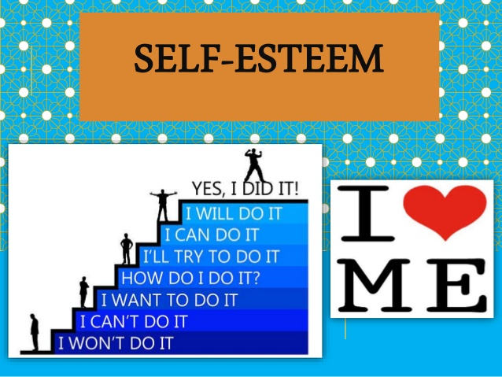

Slide 3
Self Esteem
In simple terms:
Self esteem means, confidence in one's own worth or abilities; self-respect.
Self-esteem refers to a person's beliefs about their own worth and value. It also has to do with the feelings people experience that follow from their sense of worthiness or unworthiness.
Self-esteem is important because it heavily influences people's choices and decisions. In other words, self-esteem serves a motivational function by making it more or less likely that people will take care of themselves and explore their full potential.

Slide 4
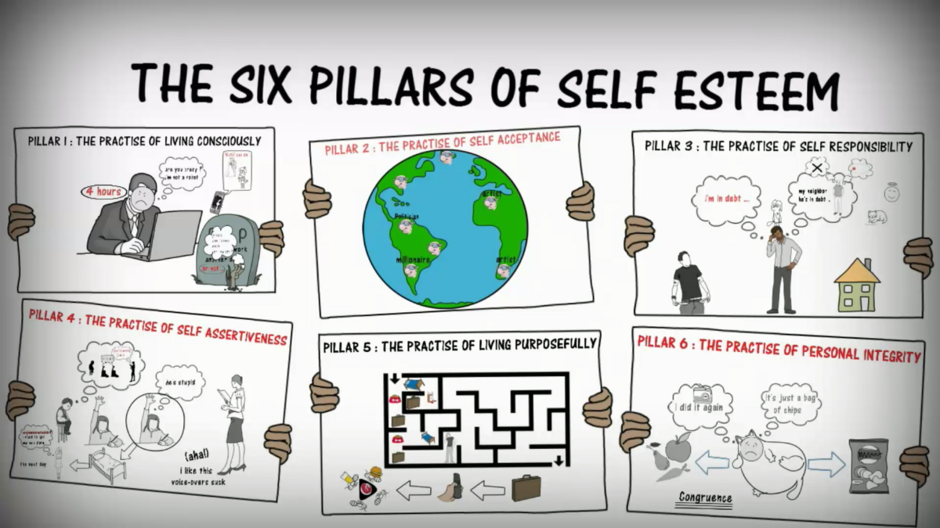

Slide 5
Self Confidence
May be termed as: a feeling of trust in one's abilities, qualities, and judgement.
It is an attitude about your skills and abilities. It means you accept and trust yourself and have a sense of control in your life. You know your strengths and weakness well, and have a positive view of yourself.
You set realistic expectations and goals, communicate assertively, and can handle criticism.

Slide 6
